Slide 1
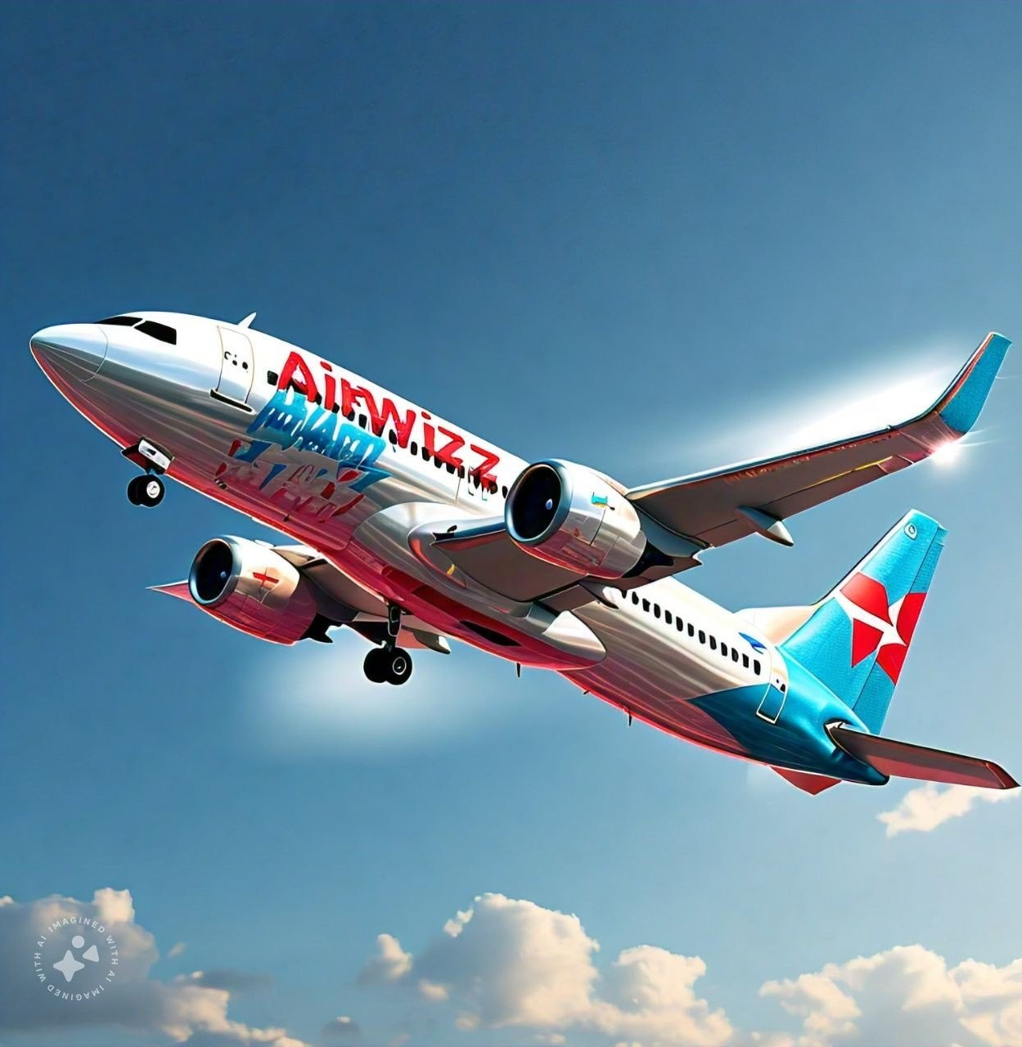

k224502 Zain Abbas k224154 Anas Ahmed k224563 Ibrahim Junaid

Slide 2


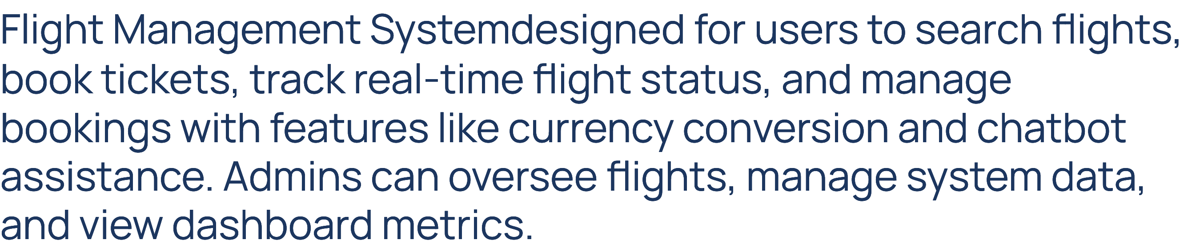

Slide 3


Slide 4

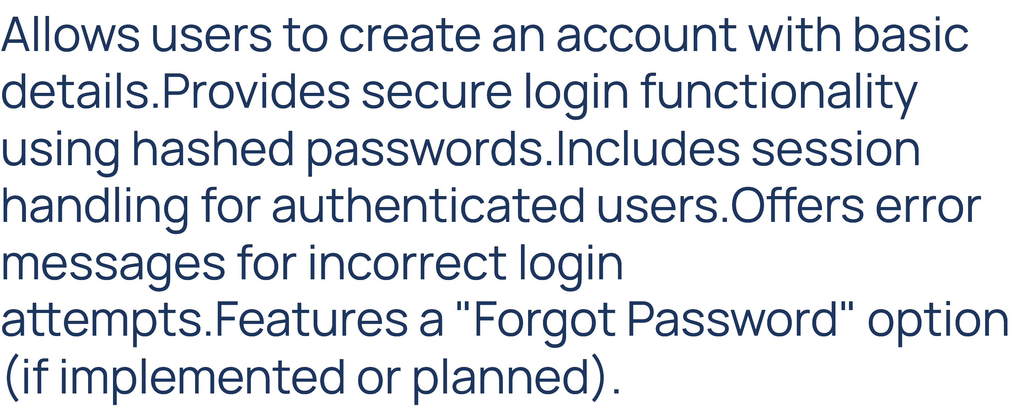

Slide 5

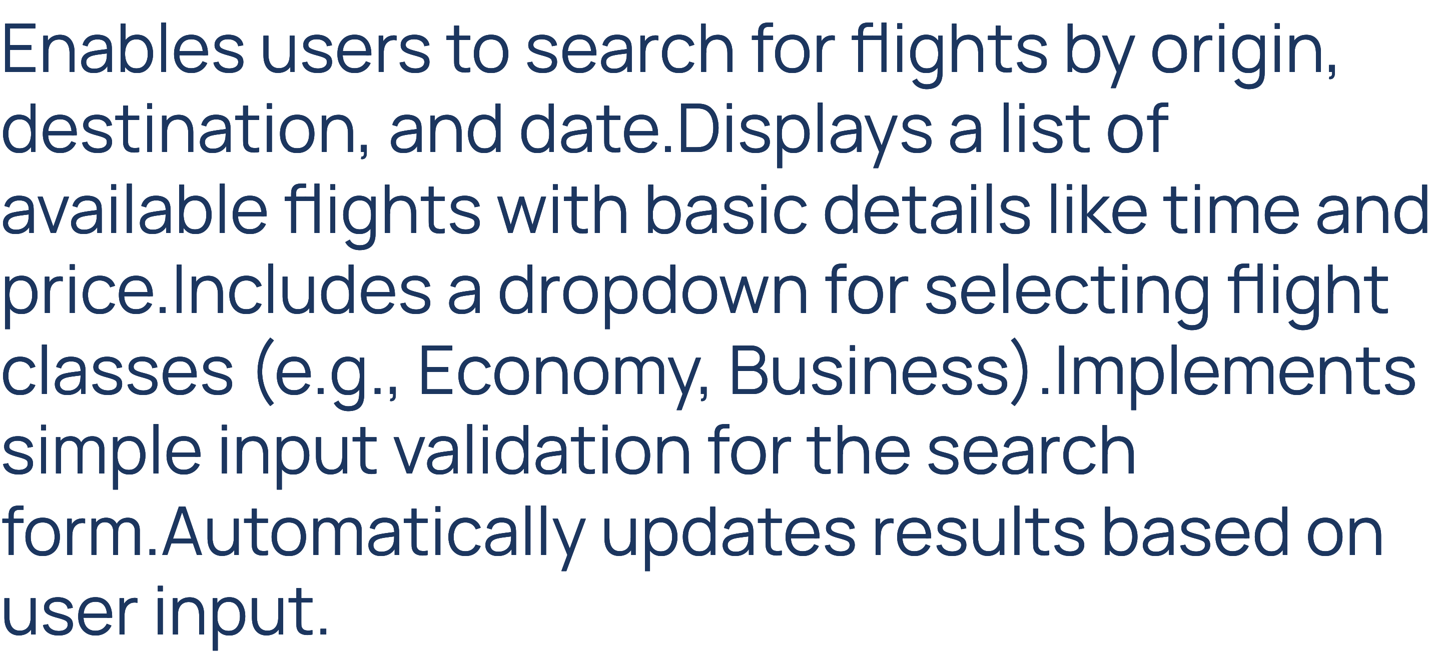

Slide 6

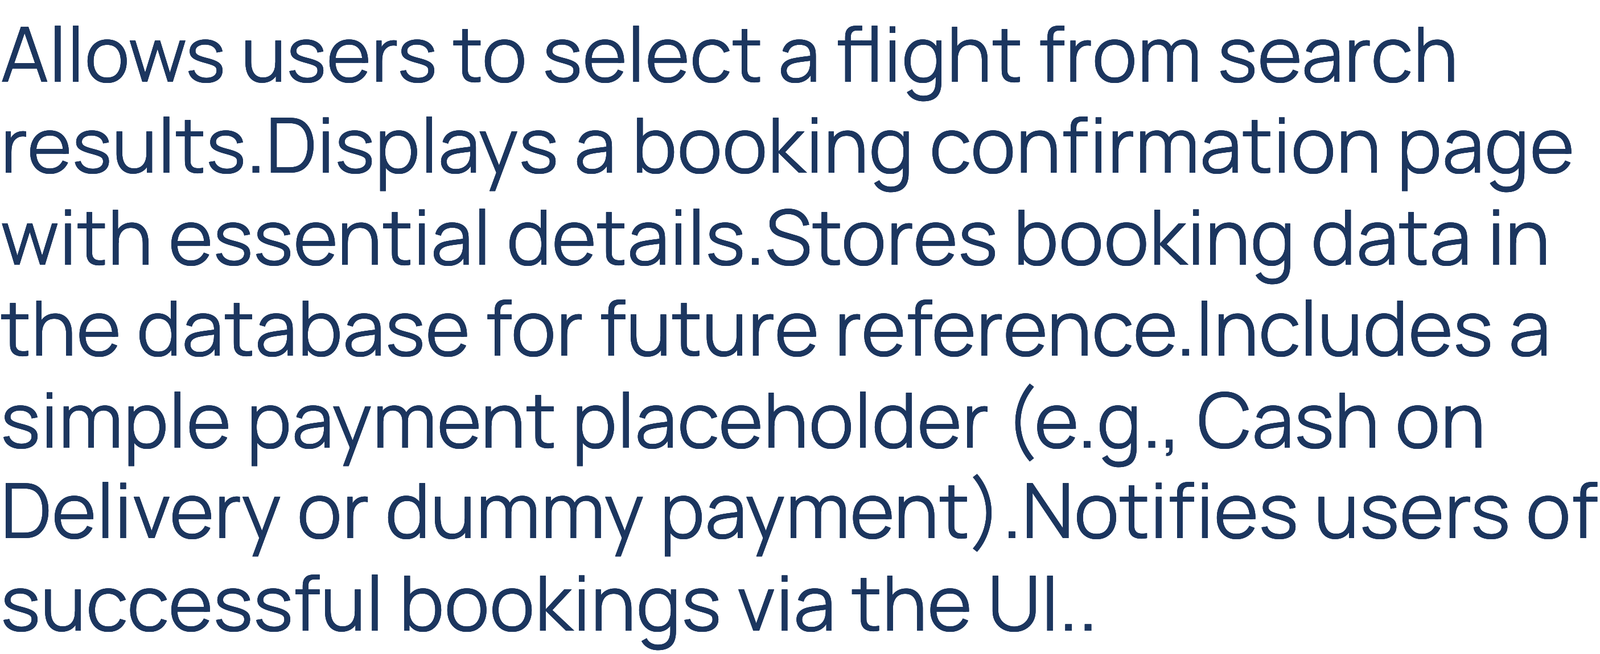

Slide 7

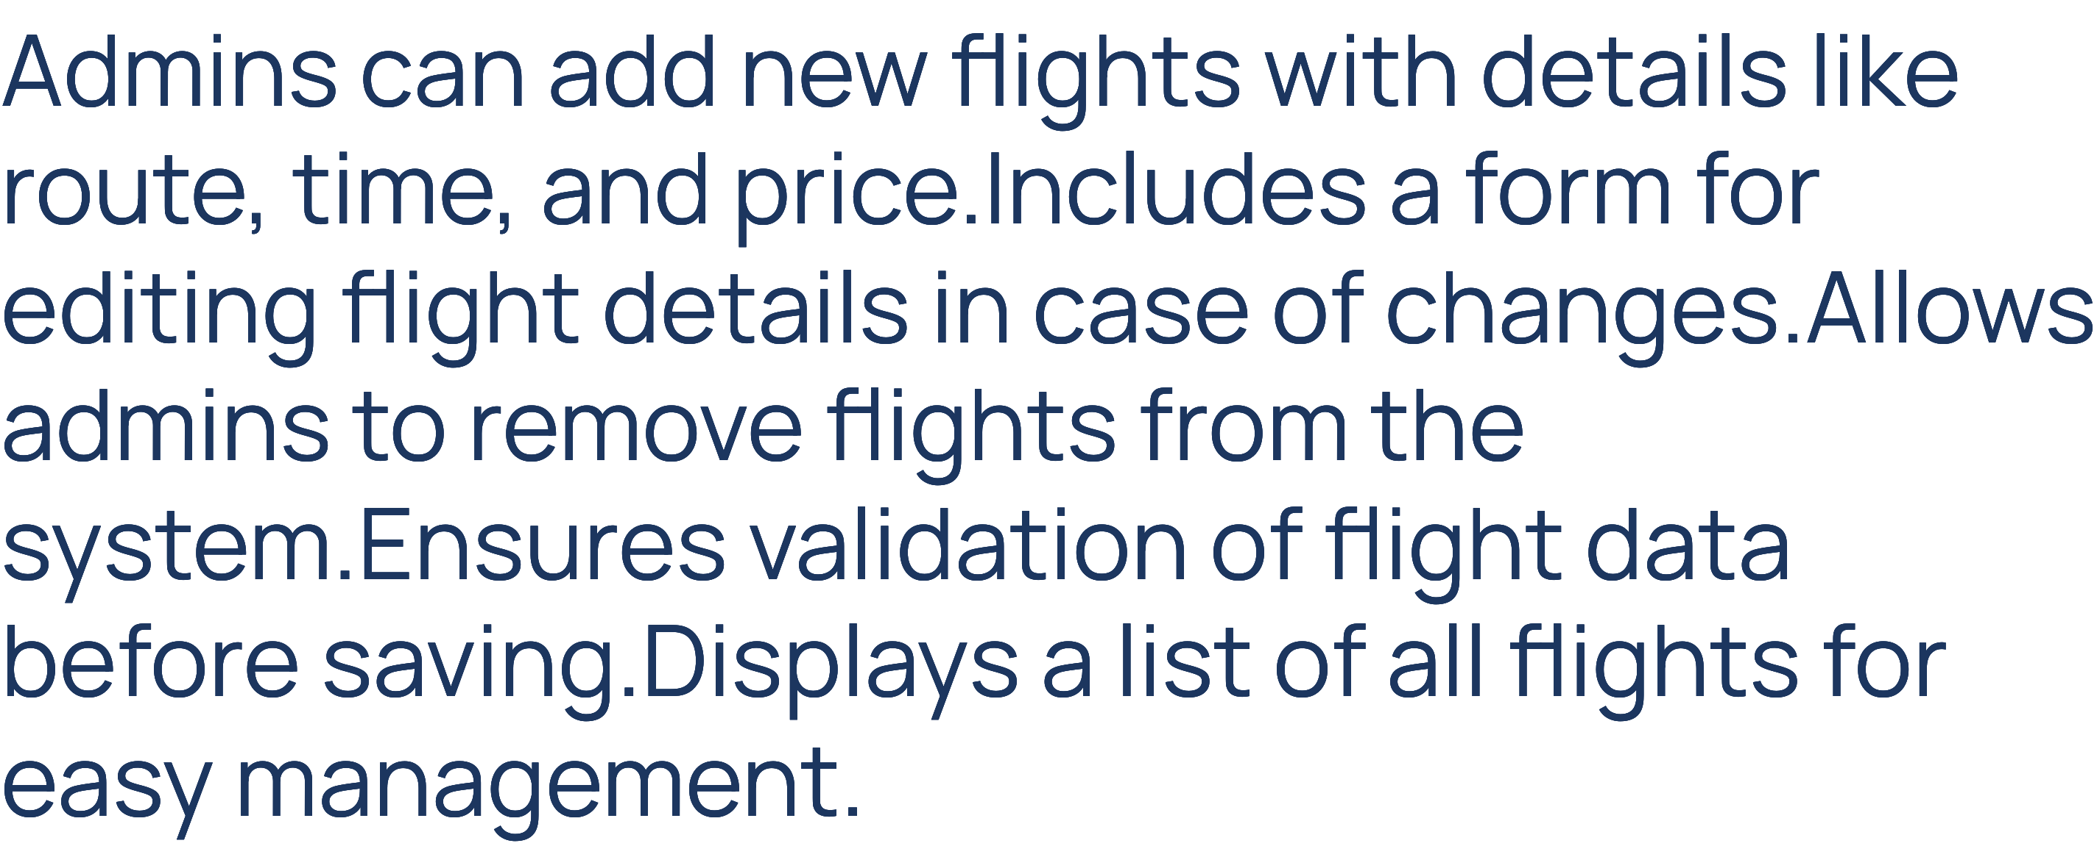

Slide 8
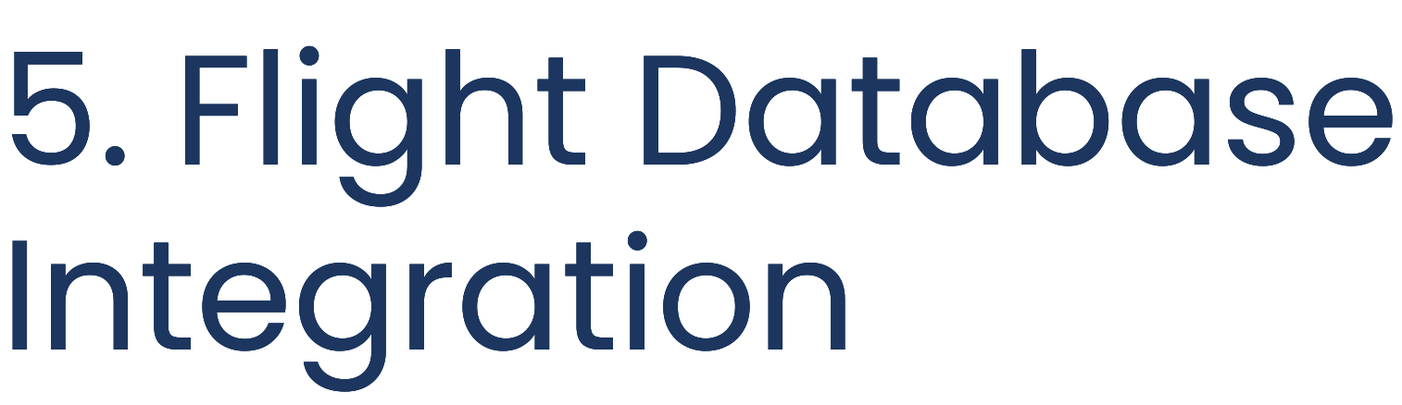
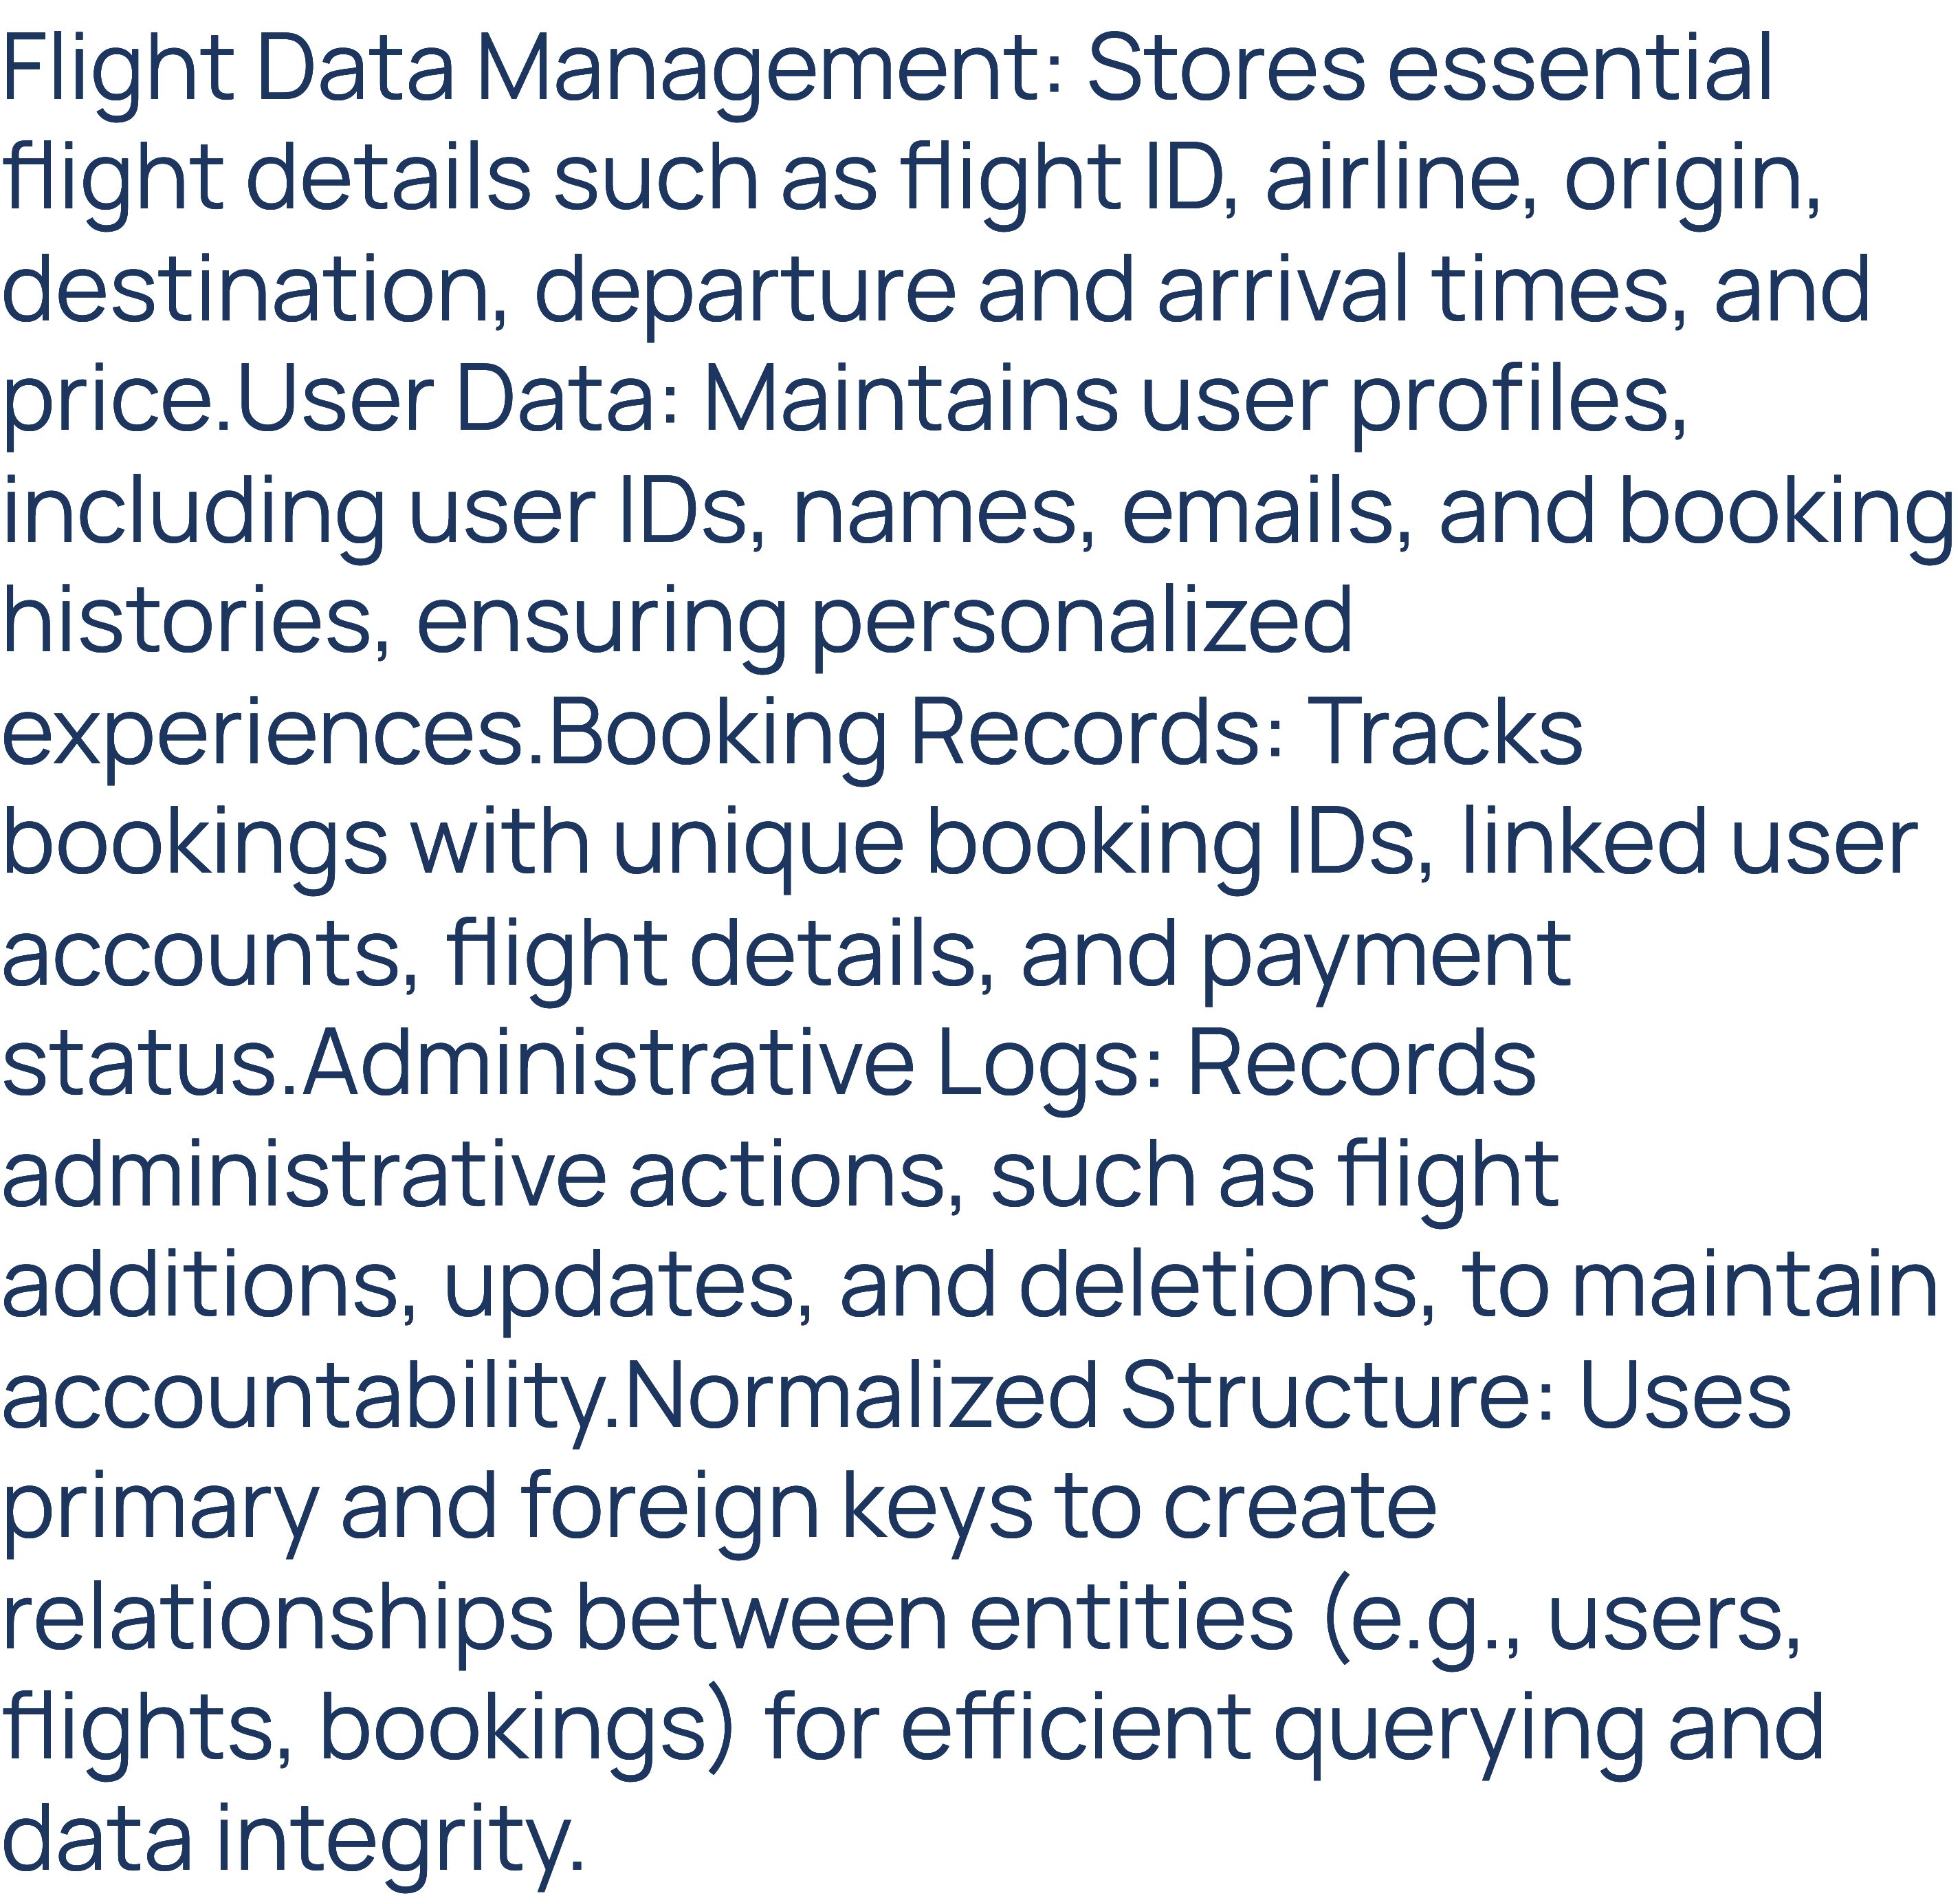

Slide 9

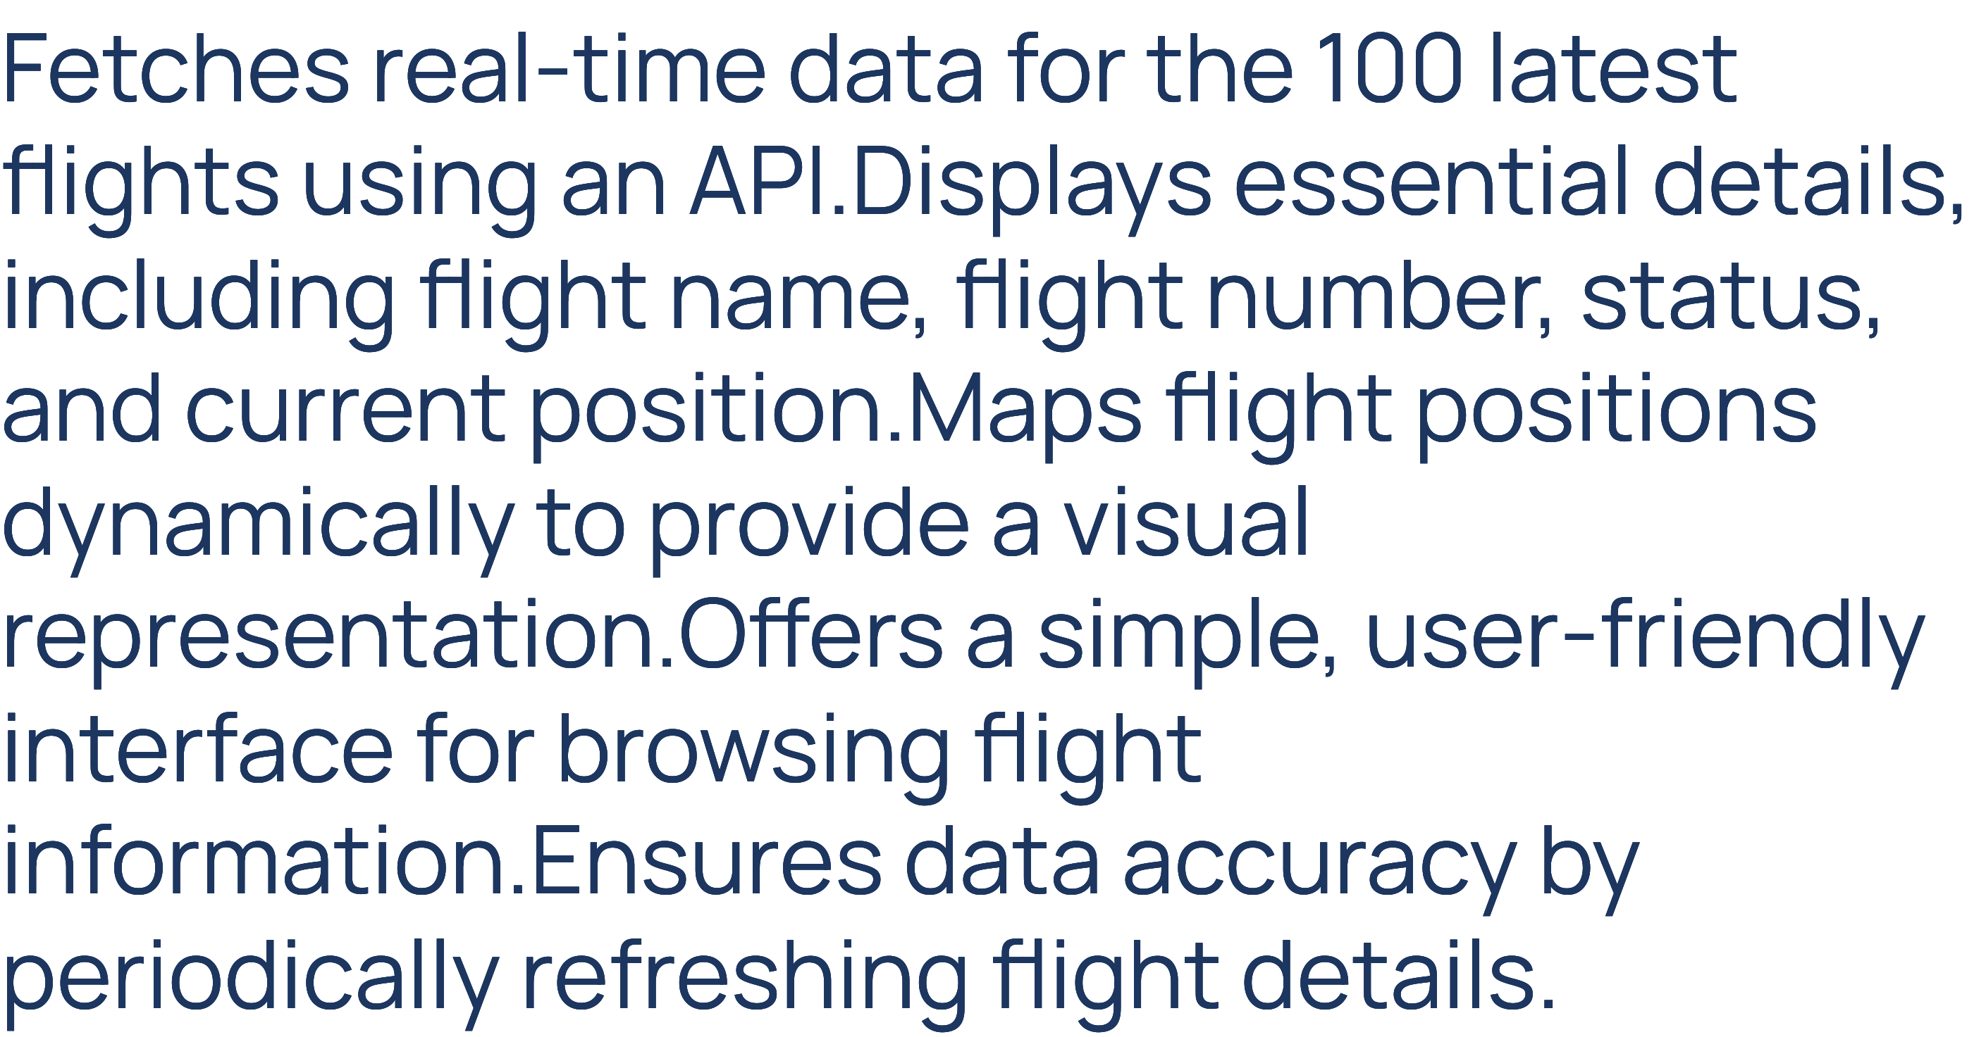

Slide 10

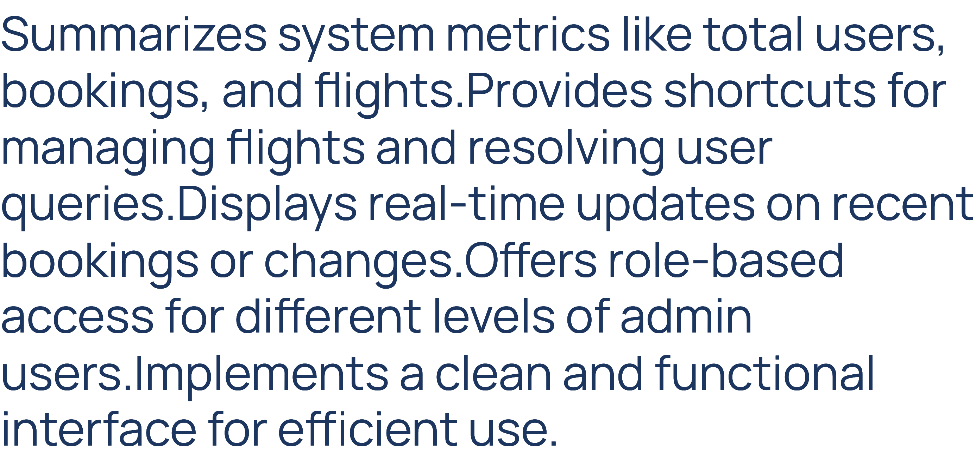

Slide 11

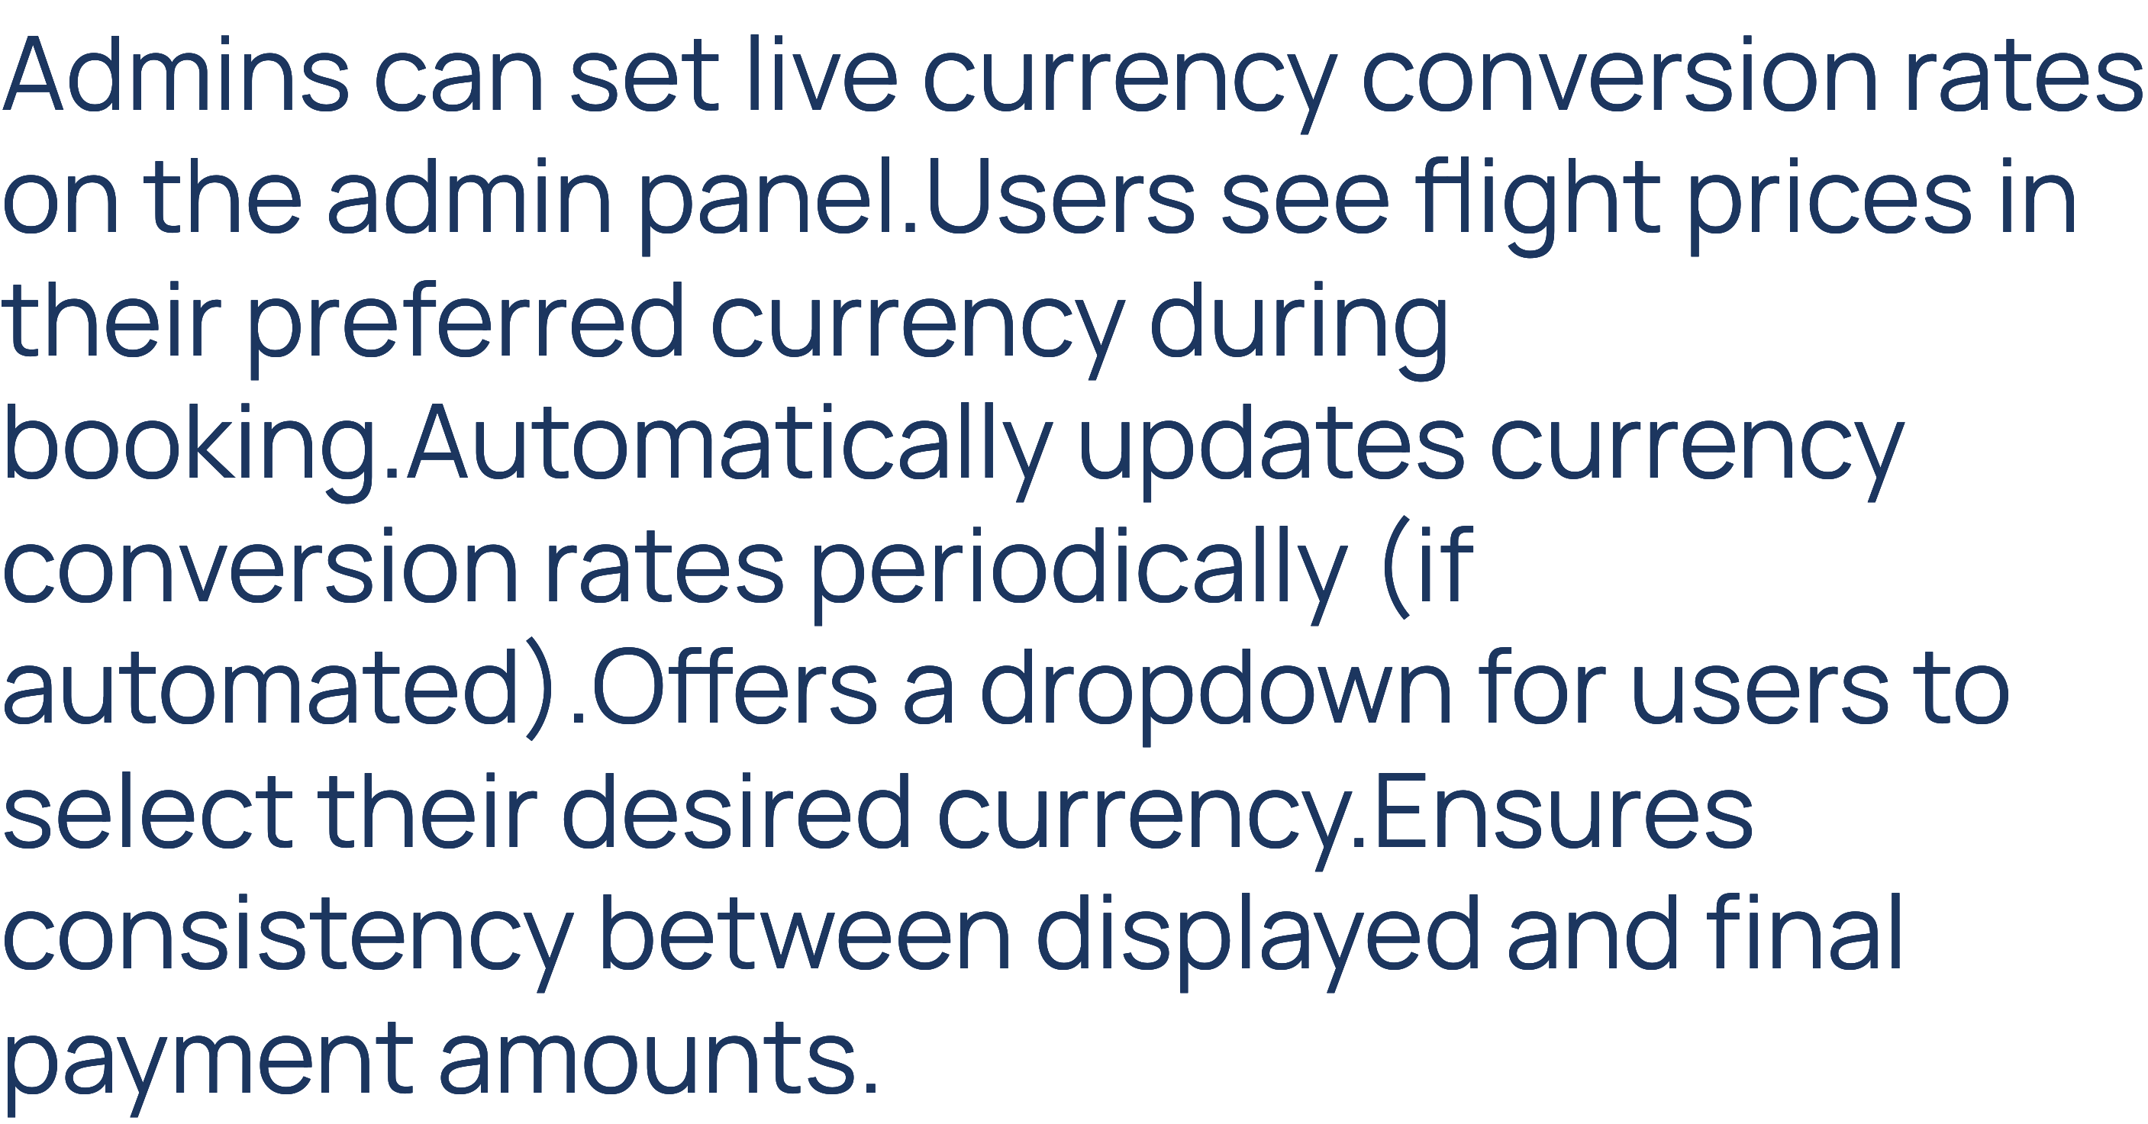

Slide 12

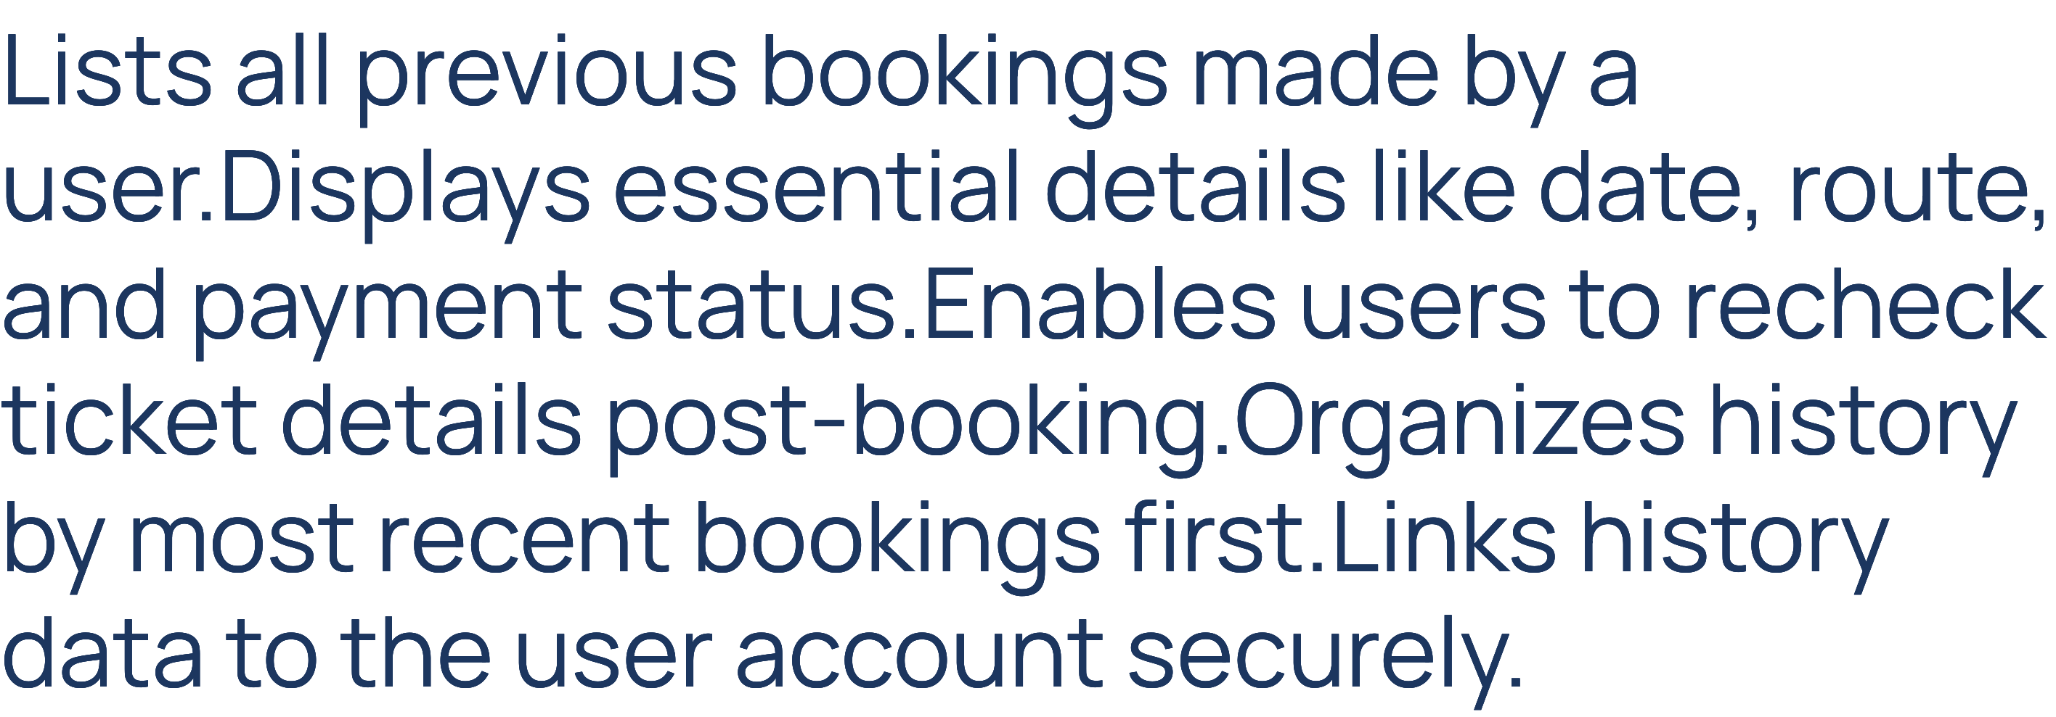

Slide 13

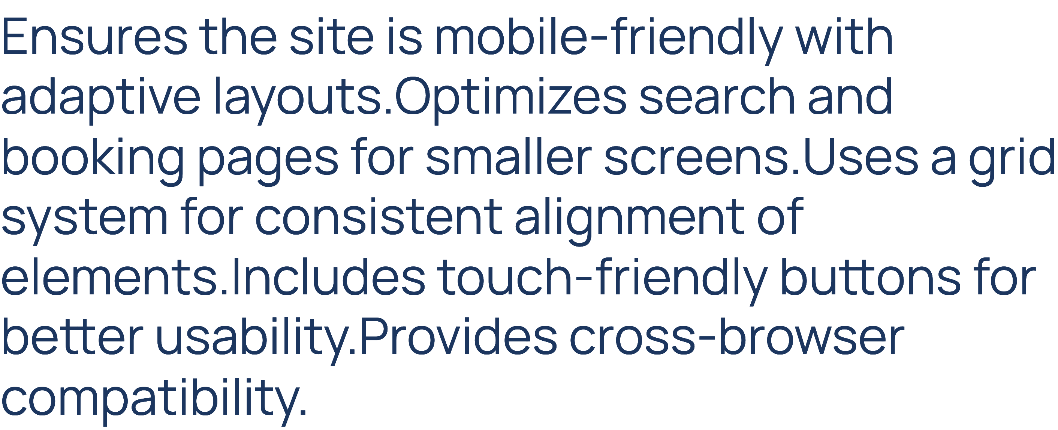

Slide 14

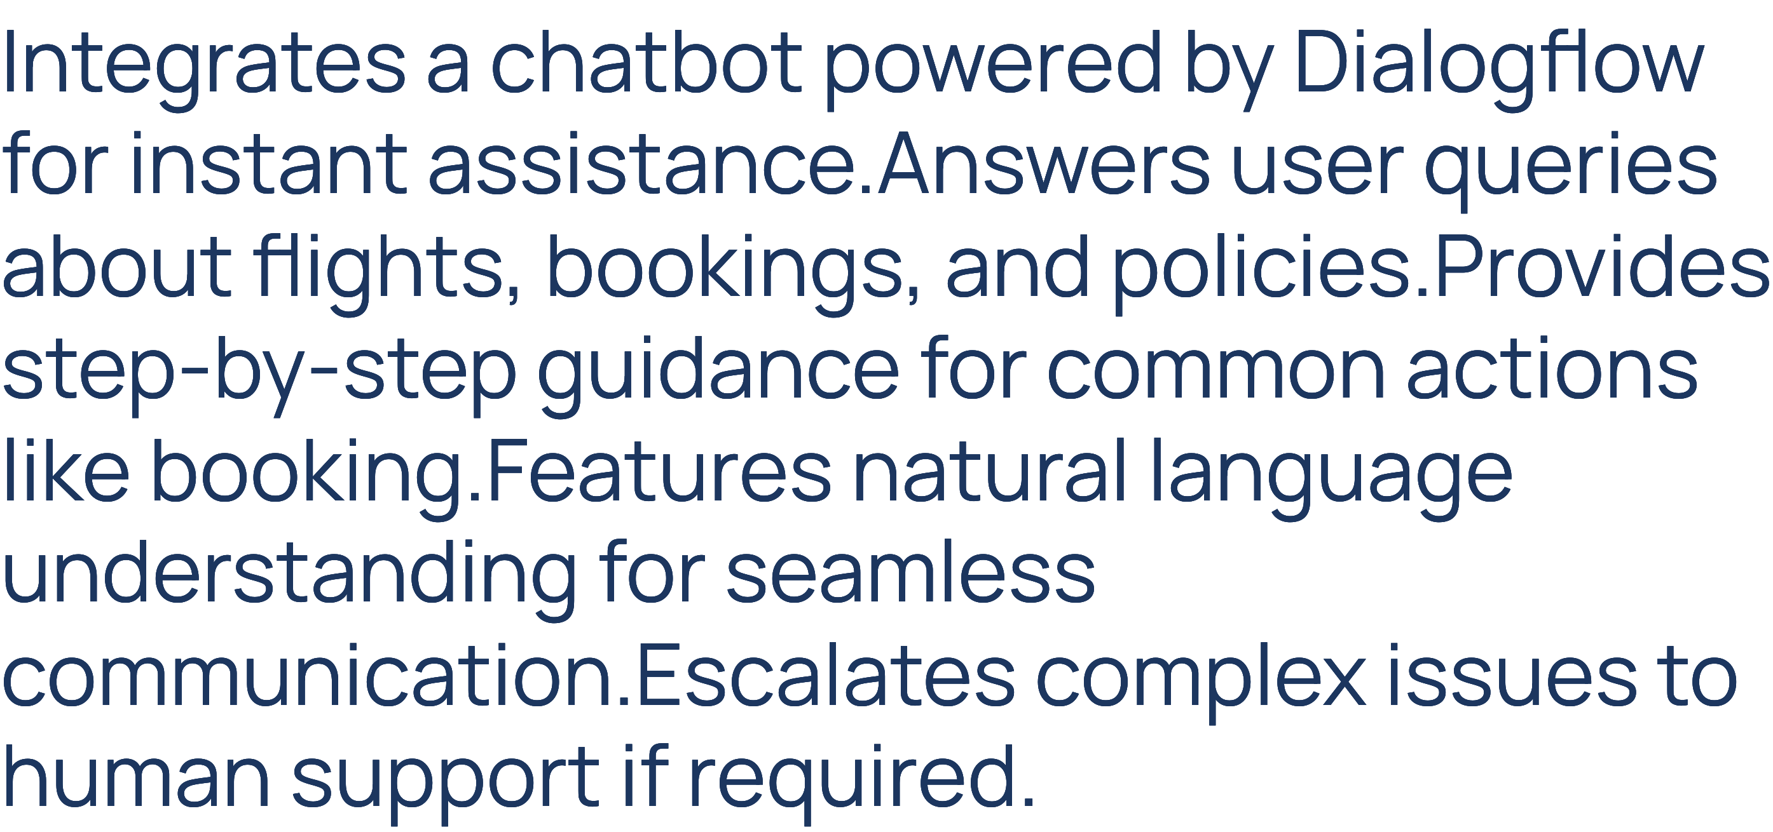

Slide 15

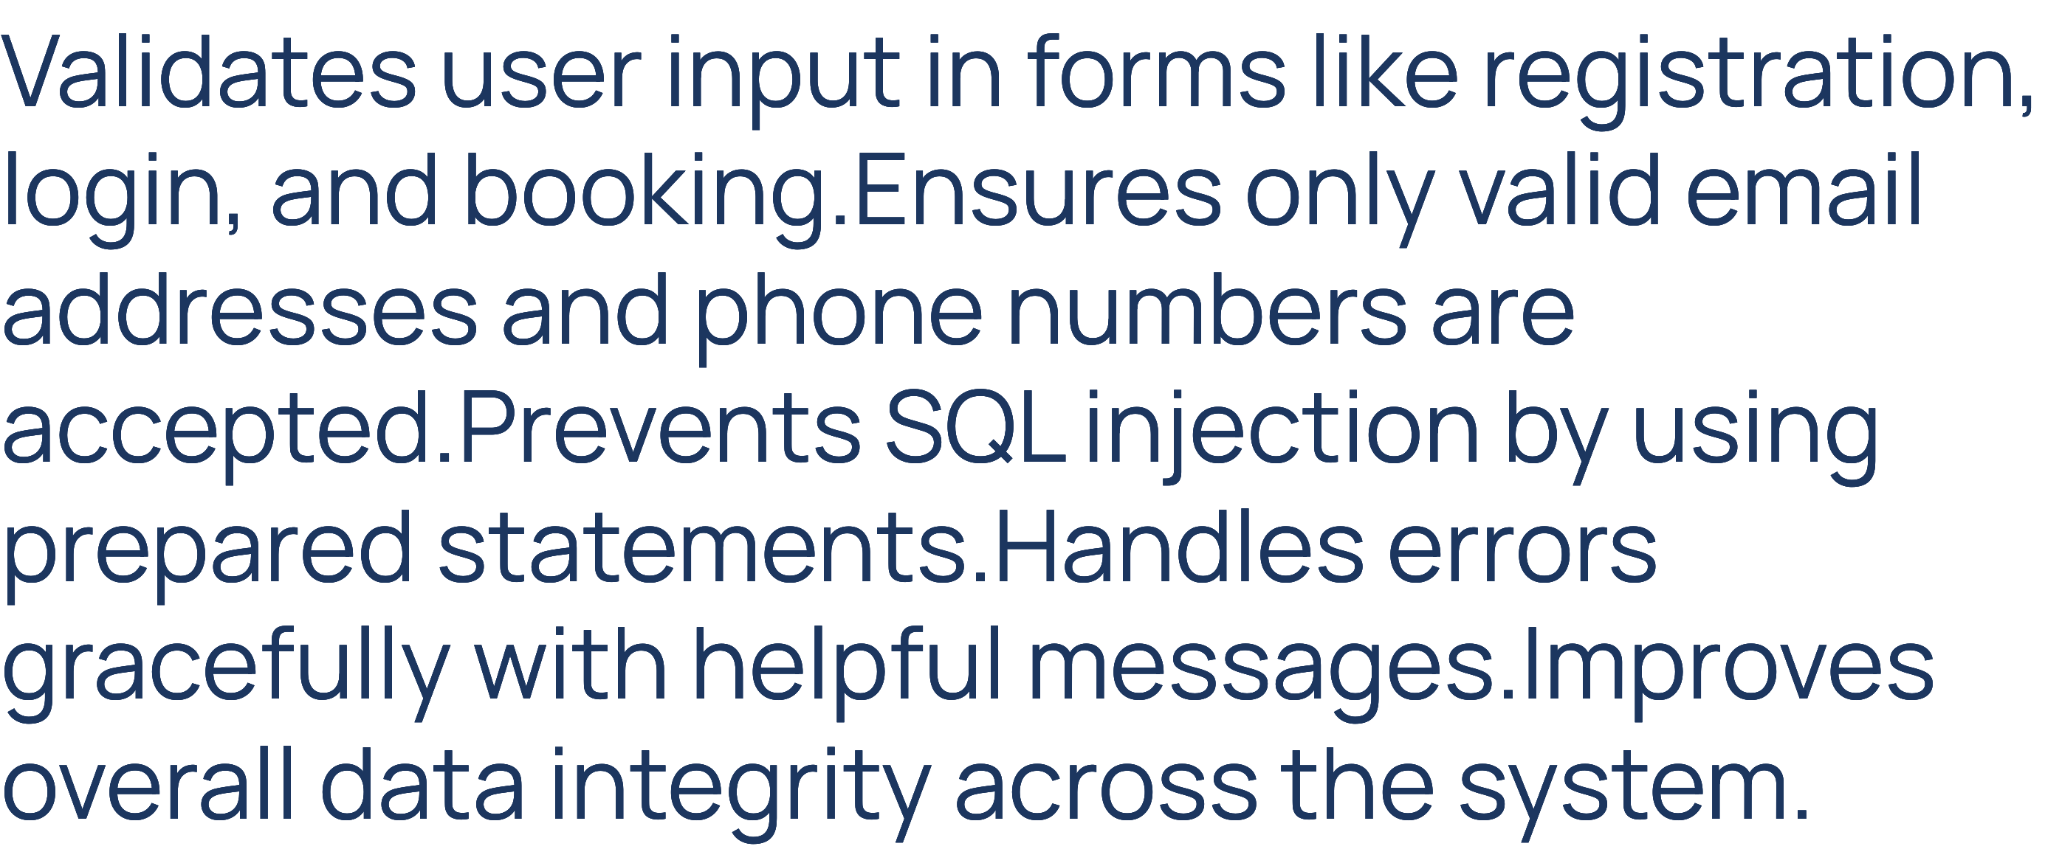

Slide 16

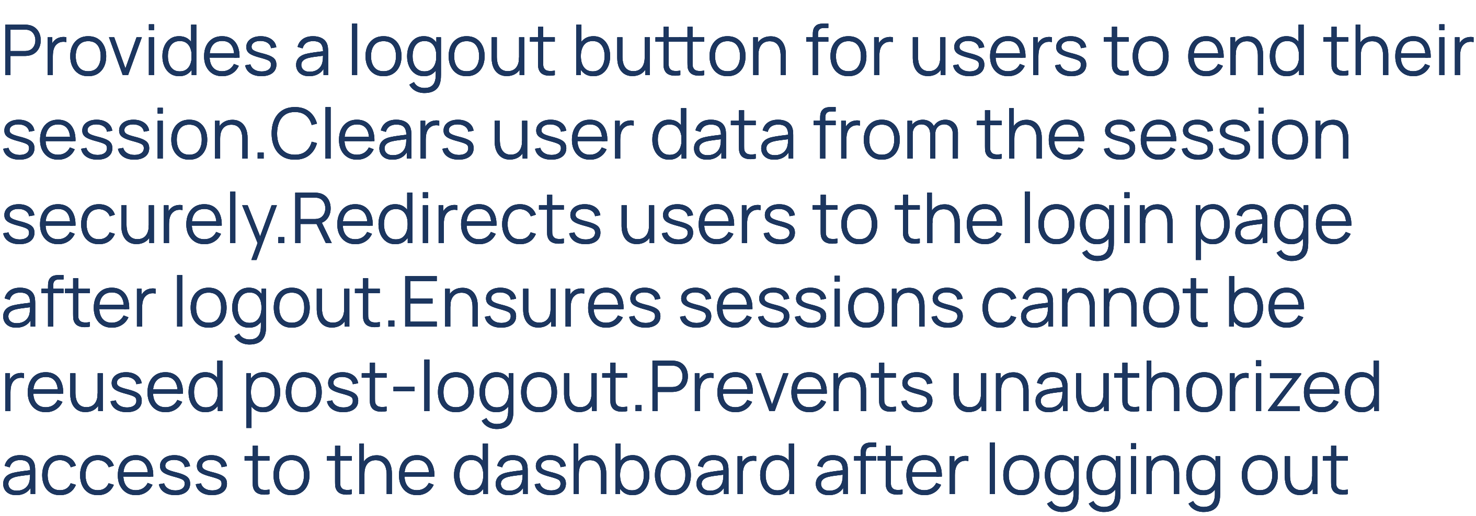

Slide 17

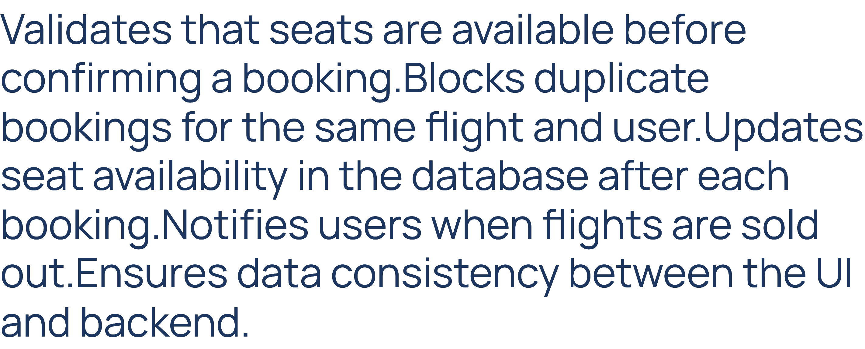

Slide 18


Slide 19

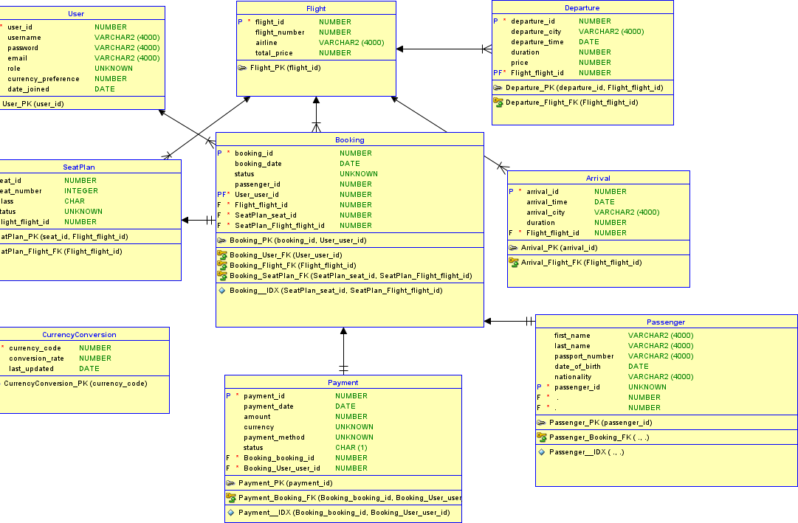

Slide 20
Operating Environment
The Air Wizz system will operate in the following environment:Hardware Platform: Web server and database server capable of supporting web applications and storing flight and user data. The hardware should be scalable to accommodate increasing traffic and data.Operating System: The system will run on Linux- based servers for the web application and database, with support for major browsers (Chrome, Firefox, Safari) for the client interface.Database: Oracle or MySQL, used for storing flight data, user information, and transactions.Web Server: Apache or Nginx, used for serving the web interface.Other Software: Payment gateway integration (e.g., PayPal, Stripe), and analytics tools.

Slide 21



Slide 22


